Slide 1
Management & Administration
Board of Directors
President
General Manger
Works Manager
Foreman
Administration
Management

Slide 2
Management – A science or an Art?
We can call a discipline scientific if its
1. methods of inquiry are systematic & empirical;
2. information can be ordered and specified; and
3. results are cumulative and communicable.
The word science is used to denote two types of systematic knowledge
1. Natural or exact
2.Behavioural or inexact

Slide 3
We place management
in the category
of Behavioral Science.

Slide 4
Management – A science or an Art? contd..
Art is concerned with the understanding of ‘HOW’ a particular work has been done.
A theoretical body of lessons and principles which a manager has learnt in a classroom will not secure for him/her the aimed results unless he/ she has also the skill( or art) of applying such principles and body of knowledge to his/ her special problem.

Slide 5
In this sense management is an art like the art of a musician or the art of a painter who seeks to achieve the desired effect with the help of his/her own skills.

Slide 6
Management – A professsion?
Mcfarland gives following characteristics of a profession:
1. Existence of an organized and systematic knowledge.
2. Formalized methods of acquiring training and experience.
3.Existence of an association with professionalisation as its goal.
4. Existence of an ethical code to regulate the behaviour.
5. Charging the fees base on service.

Slide 7
“ No greater damage could be done to our economy or to our society than to attempt to professionalize management by licensing managers, for instance. Or by limiting access to management to people with a special academic degree.”

Slide 8
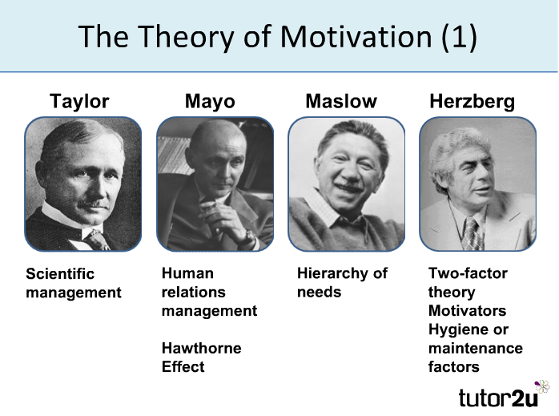
Theories of management

Slide 9
Management Theory
Classical Approaches
Frederick Taylor: Scientific Management (1886)
Frank and Lillian Gilbreth: Time/motion studies (later 1800s)
Henri Fayol: 14 Principles of Management (1880s-1890s)
Behavioral Approaches
Chester Bernard (1930s – 1960s)
Elton Mayo ( 1880 -1949)

Slide 10
Classical Approaches
Frederick Taylor: Scientific Management (1886)
Frank and Lillian Gilbreth: Time and motion studies (later 1800s)
Henri Fayol: Fourteen Principles of Management (1880s-1890s)

Slide 11
Frederick W. Taylor
Developed Scientific Management
Laid foundation for the study of management
Key ideas:
Management as a separate field of study
Explicit guidelines for scientific study of management functions
Time studies for setting standards
Functional specialization of managers’ duties
Piece-rate Incentive systems

Slide 12
Taylor’s Principles of Management
The “one best way.”
Management using scientific observation
Scientific selection of personnel
Put right worker in right job, find limitations, train
Financial incentives
Putting right worker in right job not enough
A system of financial incentives is also needed
Functional foremanship
Division of labor between manager and workers
Manager plans, prepares, inspects
Worker does the actual work
“Functional foremen” , specialized experts, responsible for specific aspects of the job

Slide 13
Frank & Lillian Gilbreth
Time and motion efficiency experts
Developed therbligs, breakdown of manual skills into 18 actions
Therbligs are 18 kinds of elemental motions used in the study of motion economy in the workplace. A workplace task is analyzed by recording each of the therblig units for a process, with the results used for optimization of manual labor by eliminating unneeded movements.

Slide 14
Frank was a lazy bricklayer looking for an easier way and Lillian was a psychologist.
Endorsed piece-work and suggested a higher rate per unit if his directions were followed.
Disagreed with Taylor’s idea that management should choose which workers took which jobs.

Slide 15
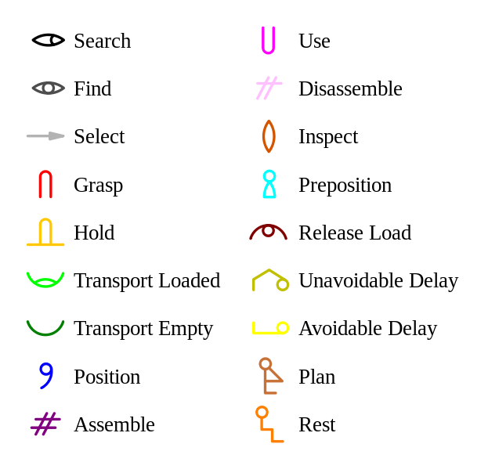

Slide 16
Transport empty [unloaded] (TE): reaching for an object with empty hand. ((called now (reach).))
Grasp (G): grasping an object by the active hand.
Transport loaded (TL):moving an object using a hand motion.
Hold (H): holding an object.
Release load (RL): release control of an object.
Preposition (PP):positioning and/or orienting an object for the next operation and relative to an approximation location.
Position (P): positioning and/or orienting an object in the defined location.
Use (U): manipulate a tool in the intended way during the course working.
Assemble (A): joining two parts together.
Disassemble (DA): separating multiple components that were joined.

Slide 17
Search (Sh): attempting to find an object using the eyes and hands.
Select (St): choosing among several objects in a group.
Plan (Pn): deciding on a course of action.
Inspect (I): determining the quality or the characteristics of an object using the eyes and/or other senses.
Unavoidable delay (UD): waiting due to factors beyond the worker's control and included in the work cycle.
Avoidable delay (AD): waiting within the worker's control causes idleness that is not included in the regular work cycle.
Rest to over come a fatigue (R): resting to overcome a fatigue, consisting of a pause in the motions of the hands and/or body during the work cycles or between them.
Find (F): A momentary mental reaction at the end of the Search cycle. Seldom used.

Slide 18
Example
...Suppose a man goes into a bathroom and shave. We'll assume that his face is all lathered and that he is ready to pick up his razor. He knows where the razor is, but first he must locate it with his eye. That is "search", the first Therblig. His eye finds it and comes to rest -- that's "find", the second Therblig.

Slide 19
Third comes "select", the process of sliding the razor prior to the fourth Therblig, "grasp." Fifth is "transport loaded," bringing the razor up to his face, and sixth is "position," getting the razor set on his face. There are eleven ot
her Therbligs -- the last one is "think“!

Slide 20
Effective
Ineffective
Reach
Move
Grasp
Release Load
Use
Assemble
Disassemble
Unavoidable Delay
Avoidable Delay
Hold
Rest
Position
Search
Select
Plan
Pre-Position

Slide 21
Henri Fayol
First came up with the five basic functions of management—Planning, Organizing, Staffing, Directing, Communicating, and Controlling
First wrote that management is a set of principles which can be learned.
Developed Fourteen Principles of Management

Slide 22
HENRI FAYOL’s
FOURTEEN PRINCIPLES OF MANAGEMENT

Slide 23
1. Specialization of labor. Specializing encourages continuous improvement in skills and the development of improvements in methods.
2. Authority. The right to give orders and the power to exact obedience.
3. Discipline. No slacking, bending of rules.
4. Unity of command. Each employee has one and only one boss.
5. Unity of direction. A single mind generates a single plan and all play their part in that plan.
6. Subordination of Individual Interests. When at work, only work things should be pursued or thought about.
7. Remuneration. Employees receive fair payment for services, not what the company can get away with.

Slide 24
8. Centralization. Consolidation of management functions. Decisions are made from the top.
9. Scalar Chain (line of authority). Formal chain of command running from top to bottom of the organization, like military
10. Order. All materials and personnel have a prescribed place, and they must remain there.
11. Equity. Equality of treatment (but not necessarily identical treatment)
12. Personnel Tenure. Limited turnover of personnel. Lifetime employment for good workers.
13. Initiative. Thinking out a plan and do what it takes to make it happen.
14. Esprit de corps. Harmony, cohesion among personnel.

Slide 25
PSYCHO ANALYTIC THEORY
SIGMUND FREUD
CONCEPTS OF ID, EGO AND SUPER EGO
STAGES OF PSYCHO ANALYSIS
ORAL STAGE
ANAL STAGE
PHALLIC STAGE
LATENCY STAGE
GENITAL STAGE

Slide 26
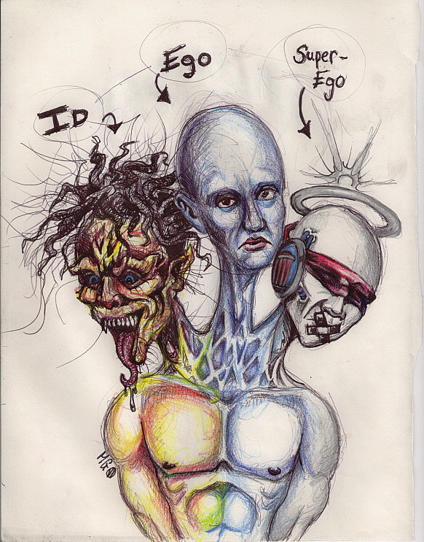
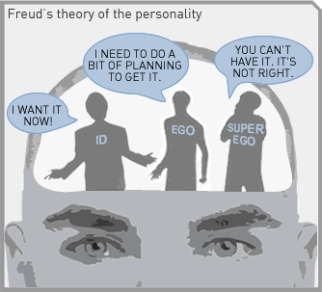

Slide 27
CLASSICAL CONDITIONING THEORY
PAVLOV
STIMULUS – RESPONSE
CONDITIONED RESPONSE AND UNCONDITIONED RESPONSE
THE CARROT – STICK APPROACH

Slide 28
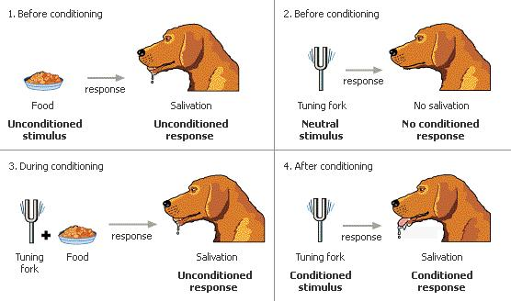

Slide 29
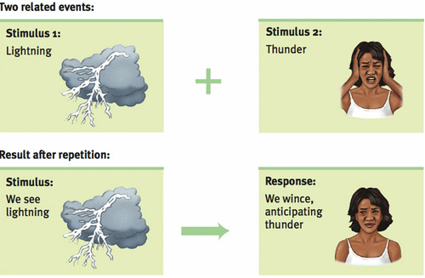

Slide 30
Behavioral Approaches
Chester Barnard (1930s – 1960s)
Elton Mayo

Slide 31
Chester Barnard 1886-1961
Informal Organization
Cliques
Naturally occurring social groupings
Acceptance Theory of Authority
Free will
Can choose to follow management orders

Slide 32

Humanistic Perspective
Emphasized understanding human behavior, needs, and attitudes in the workplace
Human Relations Movement
Human Resources Perspective
Behavioral Sciences Approach

Slide 33
Human Relations Movement
Emphasized satisfaction of employees’ basic needs as the key to increased worker productivity

Slide 34

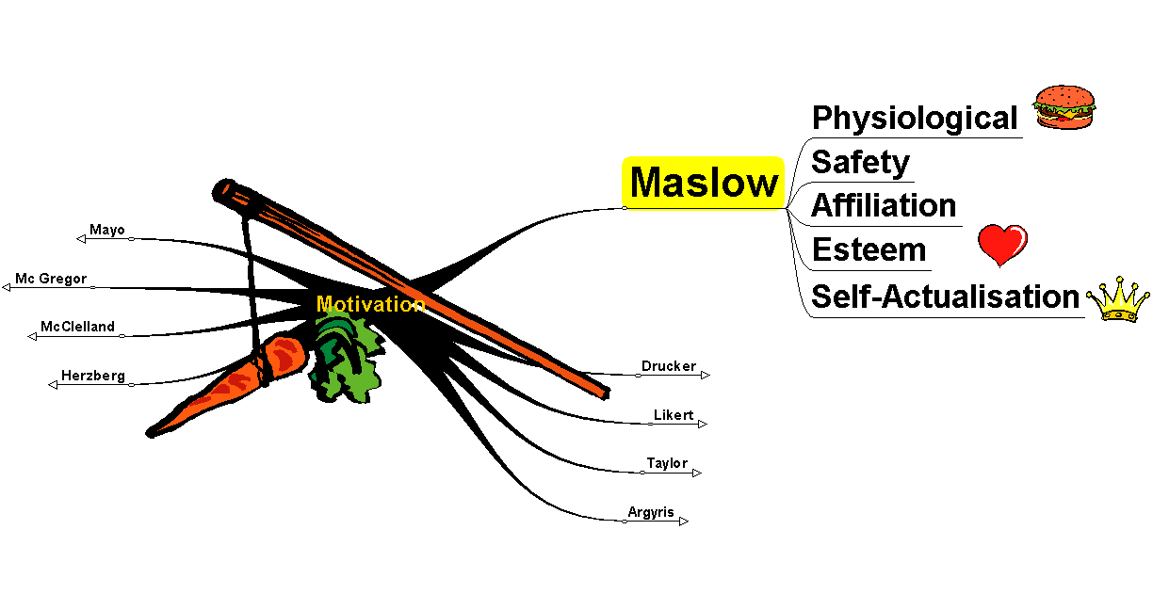
Maslow
34

Slide 35

Maslow's hierarchy of needs
Maslow's Hierarchy of Needs is a "content theory" of motivation" .Maslow's theory consisted of two parts:
(1) The classification of human needs, and
(2) Workers are not just motivated by money
but also by having their
human/social needs met.
35

Slide 36
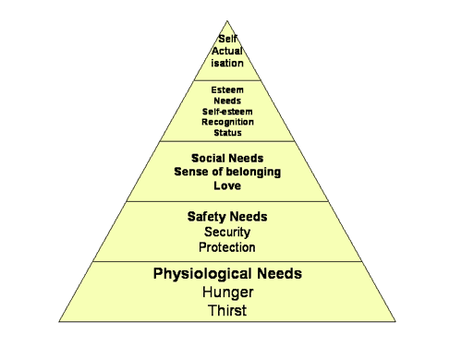
Maslow's hierarchy of needs
IB Business & Management
36

Slide 37
Content theories of Mayo
Motivation theories are categorized as either process theories or content theories.
Content theories of motivation seek to explain the specific factors that actually motivate people, i.e what motivates people.

Slide 38

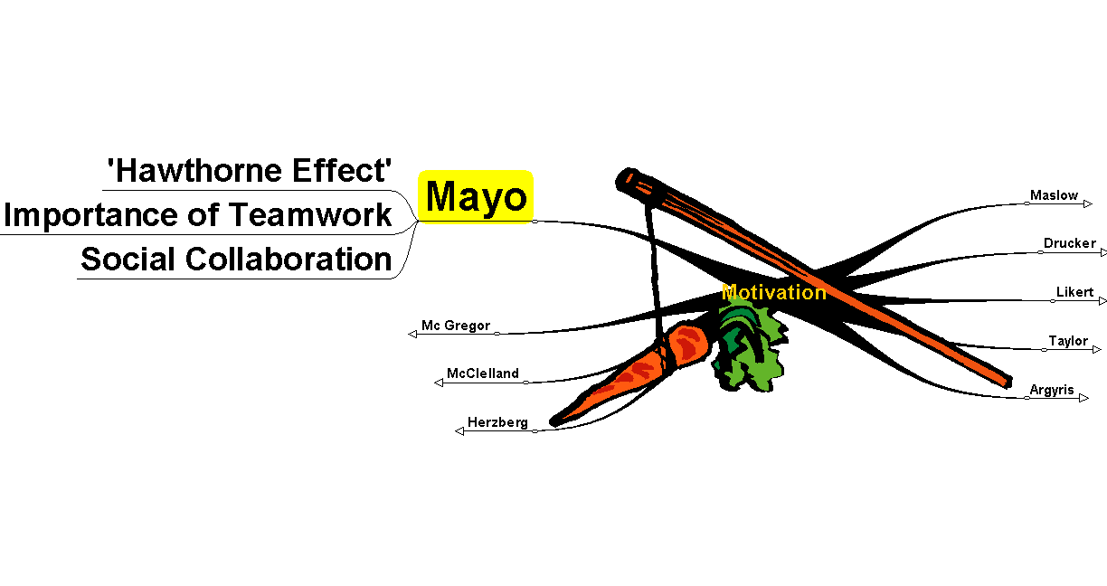
Mayo

Slide 39
The Hawthorne experiments
He carried out the HAWTHORNE experiments at a power plant in Chicago. He took a group of workers and wanted to find out what effect changing aspects of their work, the environment etc would have on their motivation.
His surprising findings were that each time their conditions changed the work rate went up, even when he finally changed back to the original conditions.

Slide 40
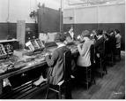

Hawthorne workers

Slide 41
His conclusions
Attention, and feeling important influence an employee's attitude
Motivation comes from more than pay and working conditions
Employees are group members - work is a group activity
Motivational factors include recognition, belonging, security
Informal groups create important bond. Supervisors need to focus on the individual social needs of workers, and the influence of informal groups

Slide 42
The Systems Approach
What’s the system approach?
Two basic types of the system: closed and open
Closed systems are not influenced by and do not interact with their environment. In contrast, an open system dynamically interacts with its environment.
An organization is an open system
The operating model in organizational systems

Slide 43
What’s the System Approach?
The system approach defines a system as a set of interrelated and interdependent parts arranged in a manner that produces a unified whole. Societies are systems and so, too, are computers, automobiles, organizations, and animal and human bodies.

Slide 44
An Organization Is an Open System
An organization is a system that interacts with and depends upon its environment.
Organization’s stakeholders:any group that is affected by organizational decisions and policies. The manager’s job is to coordinate all stakeholders to achieve the organization’s goals.
Organizational survival often depends on successful interactions with the external environment.

Slide 45
The Operating Model in Organizational System
Input
Transformation
Output
Feedback

Slide 46
BUSINESS ENVIRONMENT :
EXTERNAL AND INTERNAL ENVIRONMENT IN BUSINESS ( MACRO AND MICRO)
POLITICAL
SOCIO-CULTURAL
ECONOMIC
CONCEPT OF LPG IN BUSINESS

Slide 47
Social and Ethical Responsibility of Management

Slide 48
Organization’s Social Responsibilities
Social responsibilities
Discretionary
Don’t violate principles of right and wrong
Ethical
Obey the Law
Legal
Make a Profit
Economic

Slide 49
What’s Social Responsibility?
Corporate Social Responsibility
The idea that business has social obligations above and beyond making a profit.
Business has an obligation to constituent groups in society other than stockholders and beyond that prescribed by law.
Social Responsibility is … the ethical accountability framework for the industry which defines principles, policies and practices and codes of conduct designed to ensure:
the protection of stakeholders,
the sustainability of industry, and
quality of life improvements in the communities in which it operates.

Slide 50
Stakeholder Model
Primary Stakeholders:
Shareholders
Employees
Customers
Suppliers
Governments
Local Communities
Secondary Stakeholders:
Media Trade Associations

Slide 51
Arguments Supporting Businesses Being Socially Responsible
Public expectations
Long-run profits
Ethical obligation
Public image
Better environment
Discouragement of further government regulation
Balance of responsibility and power
Shareholder interests
Possession of resources
Superiority of prevention over cures

Slide 52
Arguments Against Businesses Being Socially Responsible
Violation of profit maximization
Dilution of purpose
Costs
Too much power
Lack of skills
Lack of accountability

Slide 53
ETHICS
Ethics (also called moral philosophy), involves systematizing, defending, and recommending concepts of right and wrong behavior.
Business ethics is the application of general ethical principles to business dilemmas.

Slide 54
TYPES OF MANAGERIAL ETHICS
Immoral management
Lacks ethical principles, concern for profit only
Amoral management
Ignores, or oblivious to, ethical issues
Moral management
Conscious attention to ethical standards and issues

Slide 55
WHAT INFLUENCES ETHICAL BEHAVIOR?
THE ORGANIZATION’S ROLE
Structure
Culture
THE INDIVIDUAL’S ROLE

Slide 56
Determinants of Individual Ethics
Family Influences
Situational Factors
Values and Morals
Experiences
Peer Influences
Individual Ethics

Slide 57
ETHICAL GUIDELINES FOR MANAGERS
Obey the law.
Tell the truth.
Show respect for people.
Stick to the Golden Rule.
Above all, do no harm.
Participation not paternalism.
Responsibility requires action.

Slide 58
MECHANISMS FOR ETHICAL MANAGEMENT
Increasing awareness of diversity
Top management commitment
Codes of ethics
Ethics committees
Ethics audits
Ethics training

Slide 59
Process of Rationalization
Mental strategies that allow employees (and others around them) to view their corrupt acts as justified
Denial of responsibility ..no choice…everyone does it
Denial of injury…no one is really injured
Denial of victim…the violated party deserves it
Social weighting…comparison…others do worst things
Appeal to higher authorities…loyalty to boss or co.
Ledger approach…accrued credits…we deserve it

Slide 60
International management
MNCs
Headquartered in one country but operate in many countries.
From ethnocentricity to geocentricity

Slide 61
Ethnocentricity: the orientation of the foreign operations based on that of the parent company
Geocentricity: total organisation viewed as an interdependent system operating in many countries.
Relationships collaborative ; communication is two way

Slide 62
Behaviors in different cultures
Geert Hofstede : culture impacts on the behavior of the employees
Identified 5 dimensions:
Individualism vs collectivism
Large power distance vs small power distance
Uncertainty tolerance vs uncertainty avoidance

Slide 63
Masculinity vs feminity
Long term orientation vs short term orientation

Slide 64
